Slide 1

Introduction to Cloud Computing
Week 4
Challenges, Models & Services
CS-4037
Muhammad Sudais
muhammad.sudais.v@nu.edu.pk

Slide 2
CHAPTER 4 Cloud Computing Model
|Cloud Computing

Slide 3
STANDARD CLOUD MODEL
Any technology needs a standard model for the conveniences of understanding uniformity.
Cloud Computing Commercialization: After years of research and innovation, cloud computing is now commercially available.
Early Conceptualization: Initially, different groups like academicians, engineers, architects, developers, and consumers offered various interpretations of cloud computing. These interpretations had limitations and lacked uniformity.
Need for a Standard Model: For the success and advancement of cloud computing, a universally accepted standard model became necessary to ensure consistency and a unified understanding of the technology.
Standardization Institutions: Various institutions, such as the National Institute of Standards and Technology (NIST), International Organization for Standardization (ISO), European Telecommunications Standards Institute (ETSI), and organizations like the Cloud Security Alliance (CSA), have taken initiatives to establish guidelines and standards for cloud computing.
The Universally Accepted Model: Among the various initiatives, one particular standard model has gained widespread acceptance, which is discussed in the following sections of the text.

Slide 4
NIST Model
The NIST model of cloud computing was published by the Information Technology Laboratory at NIST in 2011.
The NIST Cloud Computing Model, developed by the National Institute of Standards and Technology (NIST), is one of the most widely accepted frameworks for understanding cloud computing. Here’s a breakdown of the key concepts discussed:
Cloud Computing as a Model:
Not a technology but a model that enables on-demand access to shared computing resources (networks, servers, storage, applications, services) via the internet.
Resources can be rapidly provisioned and released with minimal management or interaction with the service provider.

Slide 5
NIST Cloud Model Components : Characteristics
5 Essential characteristics:
On-demand self-service: Users can access computing resources as needed, without human interaction.
Resource pooling: Providers pool resources (CPU, storage, etc.) for shared use by multiple customers.
Broad network access: Resources are available over the network, accessible via standard devices.
Rapid elasticity: Resources can scale up or down as required by the user.
Measured service: Resource usage is monitored, controlled, and reported, allowing for pay-per-use models.

Slide 6
NIST Cloud Model Components : MODELS
3 cloud service models:
Infrastructure as a Service (IaaS): Provides virtualized computing resources over the internet.
Platform as a Service (PaaS): Offers a platform allowing customers to develop, run, and manage applications.
Software as a Service (SaaS): Delivers software applications over the internet, on a subscription basis.
4 cloud deployment models:
Public cloud: Available to the general public over the internet, managed by third-party providers.
Private cloud: Used exclusively by a single organization.
Community cloud: Shared by several organizations with common concerns.
Hybrid cloud: A combination of two or more cloud types (private, public, or community).

Slide 7
NIST Cloud Model Components : MuLTI-TENANCY & COMPARISONS
Multi-Tenancy:
While not listed as an essential characteristic, multi-tenancy is a key feature where multiple users share resources securely and privately. It improves operational efficiency and reduces costs, similar to other utility services like electricity or water supply.
Comparison with Cluster and Grid Computing:
All three models (cluster, grid, cloud) are distributed systems sharing many characteristics:
Resource pooling and broad network access are common.
Cloud computing uniquely supports on-demand self-service and rapid elasticity, features that are not typically found in cluster or grid computing.
Metered service is more advanced in cloud and grid computing compared to clusters, where only basic usage patterns are tracked.
This NIST model helps standardize cloud computing across industries and provides a framework to guide organizations in adopting cloud solutions.

Slide 8
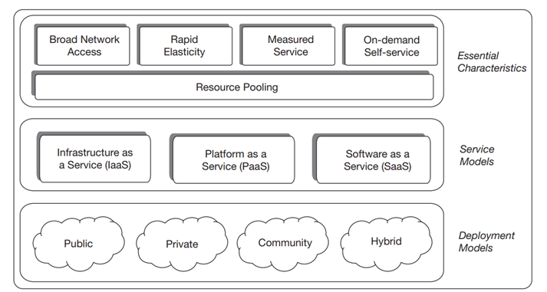
NIST Cloud ModEL

Slide 9
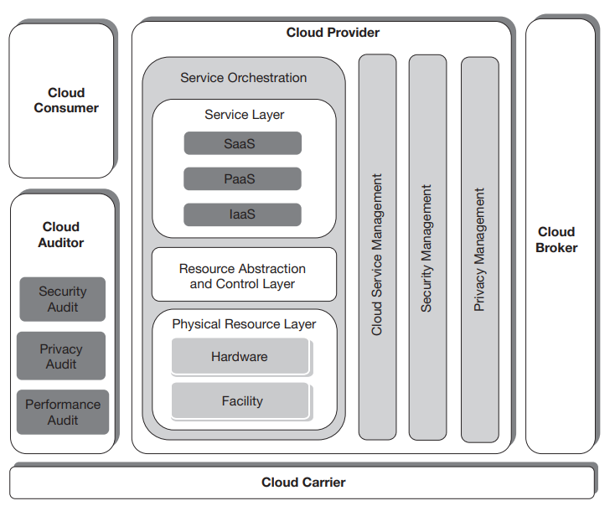
NIST cloud reference architecture
The NIST cloud reference architecture provides a high-level, vendor-neutral model.
Designed to facilitate the understanding of cloud computing by focusing on what cloud services should offer, without specifying how they should be implemented.
Published in 2011, it aims to address limitations in existing models that were either product-specific or incomplete.

Slide 10
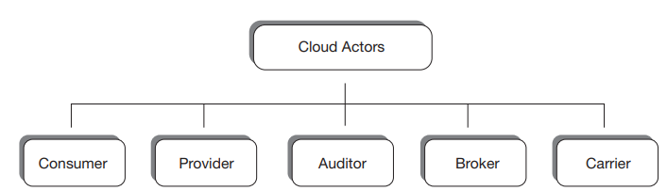
NIST cloud reference architecture : Key Actors and Their Roles
Cloud Consumer: The main stakeholder, representing individuals or organizations that use cloud services and maintain a relationship with a cloud provider.
Cloud Provider: Responsible for delivering cloud services to consumers and managing the required infrastructure.
Cloud Auditor: Conducts independent assessments of cloud services to ensure they meet agreed-upon policies and regulations.
Cloud Broker: Facilitates relationships between cloud providers and consumers, helping manage and integrate services from different providers.
Cloud Carrier: Acts as the intermediary, providing the connectivity and transport necessary to deliver cloud services between providers and consumers.

Slide 11
NIST cloud reference architecture : Cloud Provider's Responsibilities
The cloud provider's role involves these primary activities:
Service Deployment: Determining the deployment model (public, private, hybrid, or community cloud).
Service Orchestration: Coordinating and managing resources to deliver services to consumers.
Service Management: Ensuring the operation, provisioning, and interoperability of services.
Security and Privacy Management: Protecting the system and consumer data from unauthorized access while maintaining privacy.
Service Orchestration:
Orchestration involves the coordination of system components across three layers:
Service Layer: Provides interfaces for consumers to access cloud services (SaaS, PaaS, IaaS).
Resource Abstraction and Control Layer: Implements software-based control over physical resources, managing access and usage.
Physical Resource Layer: Contains all physical computing resources such as servers, storage, networking devices, and infrastructure.
This architecture clarifies roles and responsibilities in cloud ecosystems and ensures that services are delivered efficiently while maintaining security, privacy, and operational transparency.

Slide 12
Cloud Deployment Models
Cloud services can be deployed in four main ways: Public, Private, Community, and Hybrid.
Each model defines the access boundary and relationship between the cloud and the consumer organization.

Slide 13
Cloud Deployment Models : PUBLIC CLOUD
Widely accessible to anyone with a subscription.
External and off-premises, hosted by cloud vendors (e.g., AWS, Google Cloud, Microsoft Azure).
Promotes multi-tenancy (sharing resources among unrelated consumers).
Consumers have low control but financial benefits due to lower costs.
Examples: AWS, Google Cloud, Microsoft Azure, Salesforce.

Slide 14
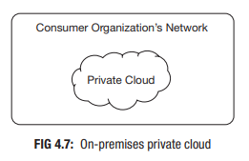
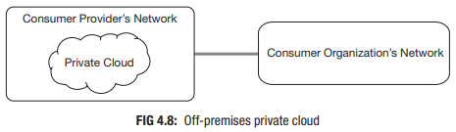
Cloud Deployment Models : Private CLOUD
Restricted access for organizational use.
Also called internal cloud, typically used by organizations with high-security needs.
Can be on-premises (inside the organization's premises) or off-premises (outside but under the organization's control).
Offers one-to-one relationship (resources dedicated to one organization, no multi-tenancy).
Provides greater control and security, but at a higher cost compared to public clouds.

Slide 15
Cloud Deployment Models : COMMUNITY CLOUD
Shared by a specific community of organizations with common concerns (e.g., security, business functions).
Can be on-premises or off-premises.
Supports multi-tenancy within a community, offering a balance between cost-efficiency and privacy.
Example: Government cloud services for national agencies.

Slide 16
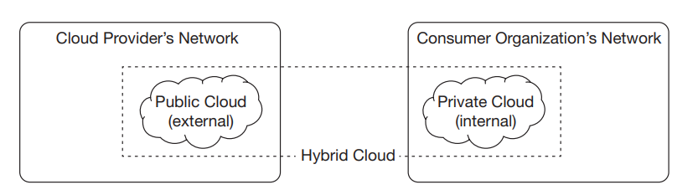
Cloud Deployment Models : HYBRID CLOUD
Combines public and private/community cloud deployments.
Critical data and applications are stored in a private or community cloud, while non-sensitive workloads use the public cloud for cost efficiency.
Provides a flexible solution for organizations seeking the advantages of both private and public cloud environments.

Slide 17
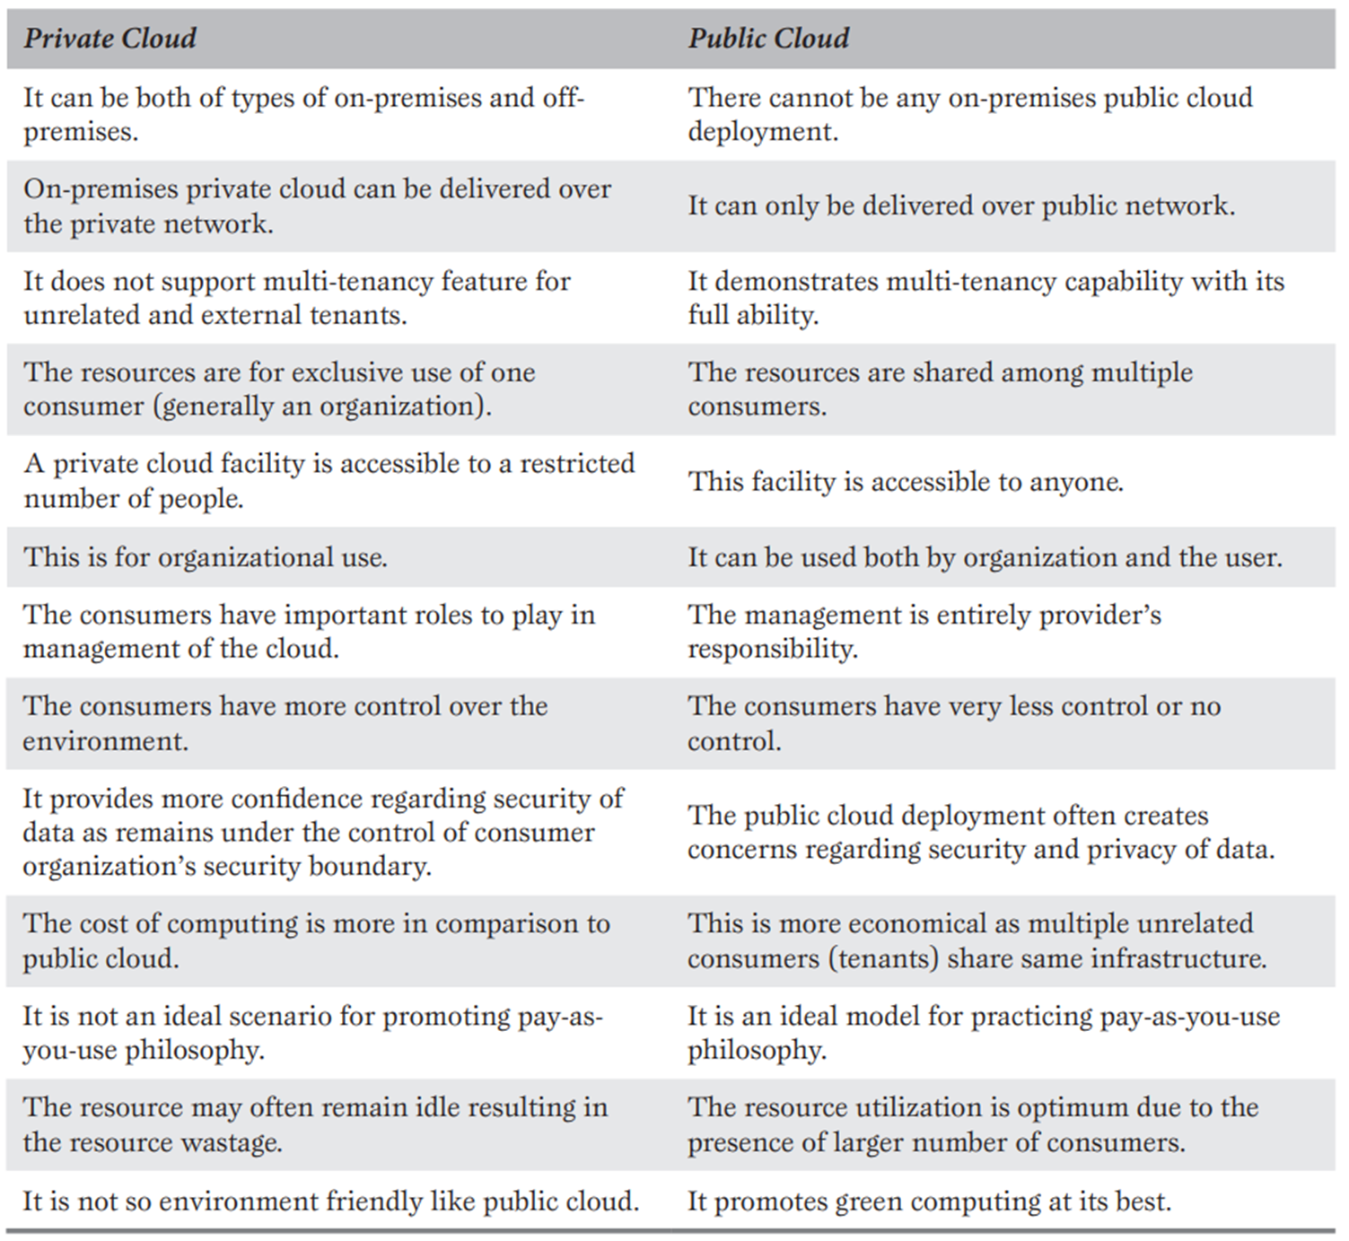
Cloud Deployment Models : PUBLIC CLOUD VS PRIVATE CLOUD

Slide 18
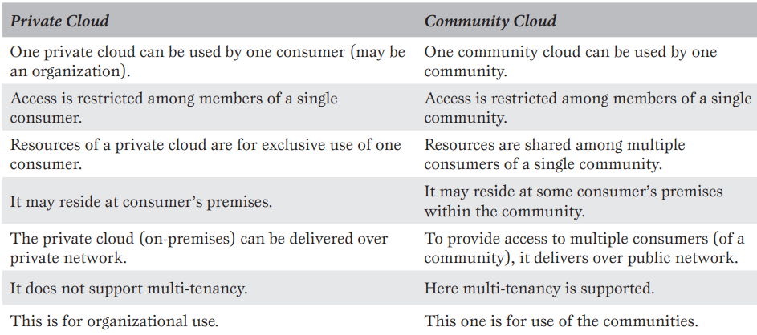
Cloud Deployment Models : PRIVATE CLOUD VS COMMUNITY CLOUD

Slide 19
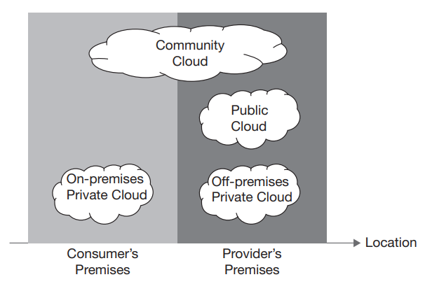
Cloud Deployment Models : PHYSICAL LOCATION

Slide 20
Choosing the Appropriate Deployment Model
The choice depends on business needs, size, and IT maturity of the organization.
Factors like security, privacy, business requirements, and budget influence the selection.
General users can opt for public cloud, while organizations may prefer private or community clouds for sensitive data.
For critical applications with security concerns, private or hybrid clouds are preferable. Public cloud is suitable for general applications.

Slide 21
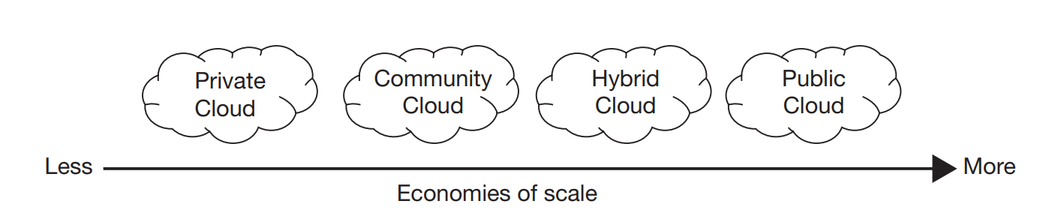
Choosing the Appropriate Deployment Model : Economies of Scale
Economies of scale result in cost advantages due to business size or volume.
Public clouds are the most economical due to multi-tenancy and a large number of consumers.
Private clouds are less economical as they don’t support multi-tenancy, being dedicated to a single organization.
Community and hybrid clouds offer intermediate cost-efficiency.

Slide 22
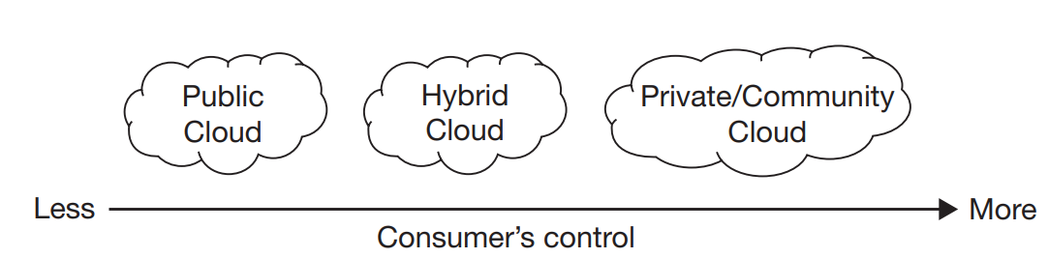
Choosing the Appropriate Deployment Model : Consumer’s Authority
Private cloud provides maximum control to consumers, especially with on-premises deployments.
In off-premises private cloud, the organization may outsource management but retains ultimate control.
Public clouds offer minimal control; the vendor retains most authority, and consumers manage only limited functions.

Slide 23
CHAPTER 5 Cloud Computing SERVICES
|Cloud Computing

Slide 24
Cloud Computing Services Overview
Introduction: Cloud computing offers scalable and on-demand computing resources over the Internet.
Deployment Models:
Public Cloud: Services are delivered over the public Internet and shared across multiple organizations.
Private Cloud: Services are maintained on a private network, offering more control and security.
Hybrid Cloud: Combines public and private clouds, allowing data and applications to be shared.
Community Cloud: Shared infrastructure for a specific community of organizations with common concerns.
Service Models:
Infrastructure-as-a-Service (IaaS)
Platform-as-a-Service (PaaS)
Software-as-a-Service (SaaS)

Slide 25
Service Delivery Models
Infrastructure-as-a-Service (IaaS):
Description: Provides virtualized computing resources over the Internet.
Benefits: Scalability, cost-efficiency, and flexibility in managing computing resources.
Platform-as-a-Service (PaaS):
Description: Provides a platform allowing customers to develop, run, and manage applications without dealing with the underlying infrastructure.
Benefits: Simplifies application development, reduces infrastructure management, and supports collaborative development.
Software-as-a-Service (SaaS):
Description: Delivers software applications over the Internet on a subscription basis.
Benefits: No need for installation, automatic updates, and accessibility from any device with an Internet connection.

Slide 26
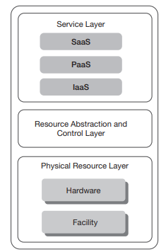
Infrastructure-as-a-Service (IaaS)
Definition: Delivers virtualized hardware resources such as servers, storage, and networking.
Features:
Virtual Resources: Virtual processors, memory, storage, and networking.
Cost Model: Pay-as-you-go for the resources used.
Examples: Amazon EC2, Google Compute Engine, Microsoft Azure VMs.

Slide 27
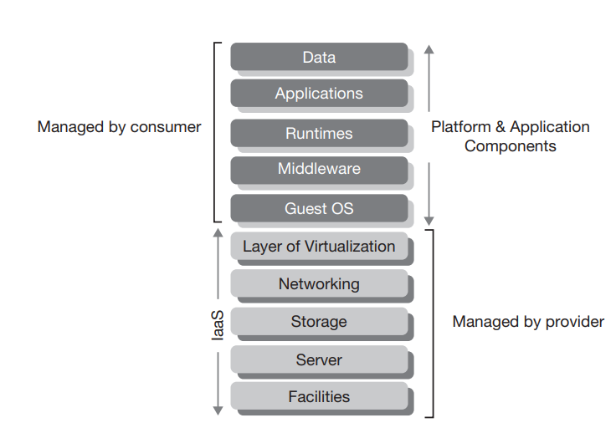
IaaS Component Stack
Components:
Managed by Provider: Hardware, networking, storage.
Managed by Consumer: Applications, operating systems, runtime environments.
Benefits: Outsources management of physical hardware while allowing customization of virtual resources.

Slide 28
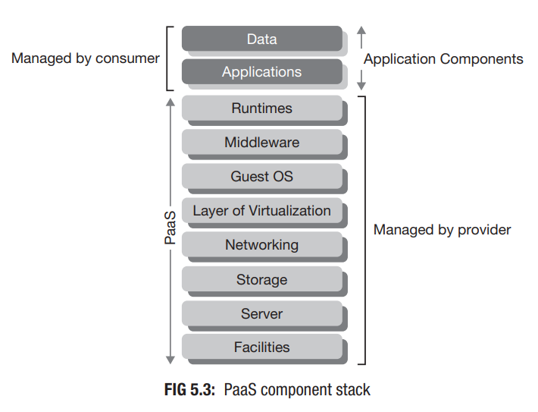
Platform-as-a-Service (PaaS)
Definition: Provides a platform for developers to build, deploy, and manage applications without managing the underlying infrastructure.
Features:
Integrated Development Environment: Tools and services for application development.
Managed Environment: Includes operating systems, middleware, and runtime libraries.
Examples: Google App Engine, Microsoft Azure App Services, Heroku.

Slide 29
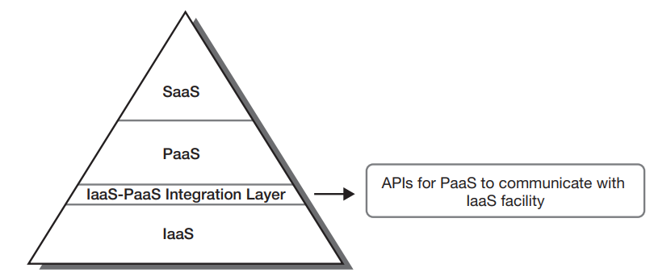
PaaS–IaaS Integration
Integration Mechanism: PaaS utilizes APIs provided by IaaS to access and manage underlying infrastructure resources.
Benefits: Simplifies application development and deployment by abstracting infrastructure management.
Example: Google App Engine uses Google Cloud’s IaaS resources for scalable infrastructure.

Slide 30
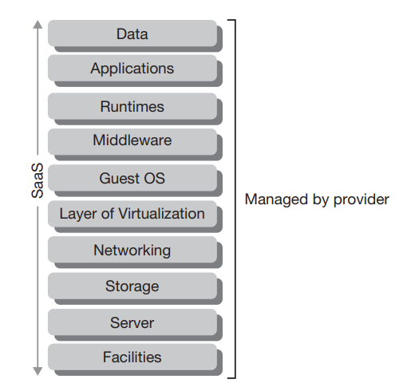
Software-as-a-Service (SaaS)
Definition: Provides software applications over the Internet without the need for local installation.
Features:
Accessibility: Available from any device with Internet access.
Cost Model: Subscription-based, often with a pay-as-you-go model.
Examples: Salesforce, Microsoft Office 365, Google Workspace.

Slide 31
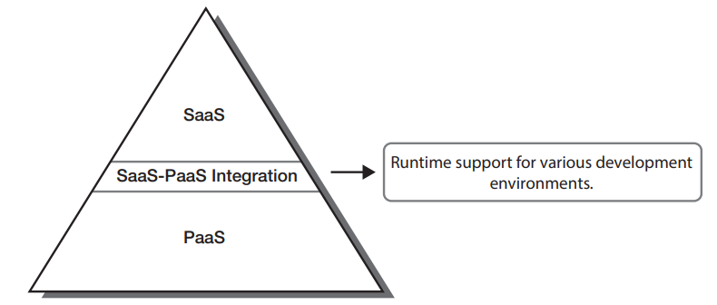
SaaS–PaaS Integration
Integration Mechanism: SaaS applications leverage PaaS environments to operate efficiently.
Runtime Support: PaaS provides the necessary runtime environments (Java, .NET, Python) for SaaS applications.
Example: SaaS applications running on Microsoft Azure use Azure’s PaaS services.

Slide 32
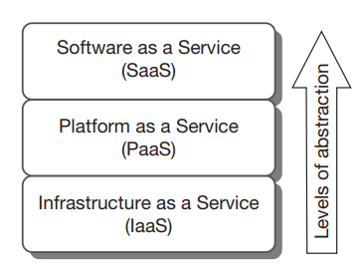
Levels of Service Abstraction
Abstraction Levels:
IaaS: Provides virtualized hardware resources.
PaaS: Provides a development platform on top of IaaS.
SaaS: Delivers end-user applications on top of PaaS.

Slide 33
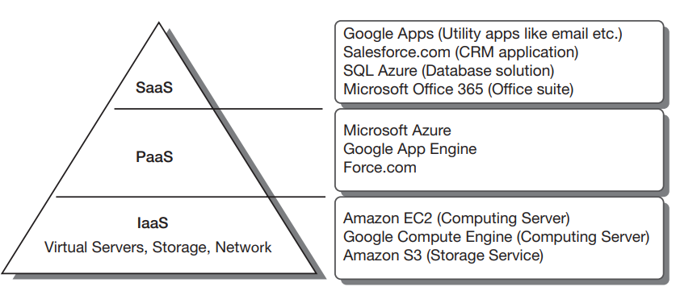
The SPI Model
Definition: The SPI model combines SaaS, PaaS, and IaaS into a layered architecture where each layer builds upon the previous one.
Benefits: Ensures a structured approach to delivering cloud services.

Slide 34
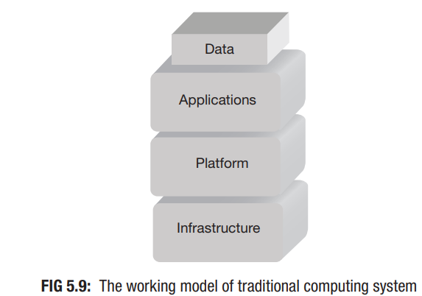
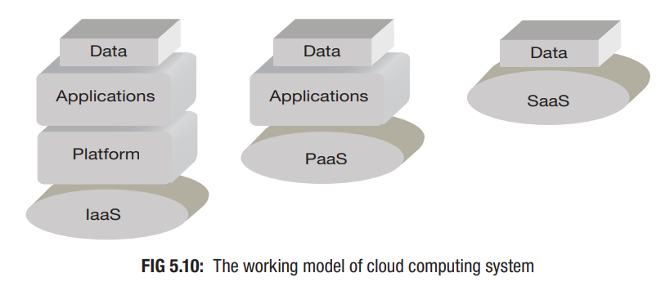
Traditional vs Cloud Computing Models
Traditional Model:
Responsibilities: Managing all layers (hardware, platform, applications) by the user.
Diagram: Figure 5.9 showing traditional computing stack.
Cloud Model:
Responsibilities: Varies by service model (IaaS, PaaS, SaaS).
Diagram: Figure 5.10 showing cloud computing stack with reduced responsibilities for users.

Slide 35
Software-as-a-Service (SaaS) vs. Application Service Provider (ASP)
SaaS: Software delivered over the web with cloud computing attributes
Core Attributes:
Rapid elasticity
On-demand self-service
Measured service
ASP (1990s): Hosted software via the web
Key Points:
Similar to traditional models
Not inherently multi-tenant or scalable

Slide 36
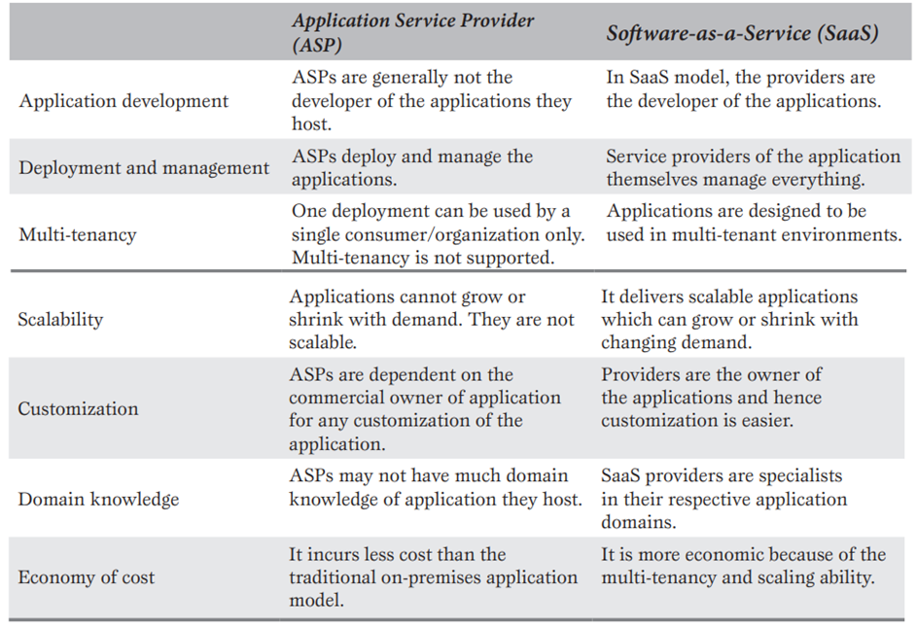
Key Differences Between ASP and SaaS

Slide 37
Advantages of SaaS Compared to Traditional Models
Licensing:
SaaS uses a subscription model, eliminating the need for upfront software licensing fees. This contrasts with traditional software, which typically requires a one-time license purchase.
Risks of Software Acquisition:
SaaS mitigates risks associated with deploying large-scale applications such as ERP or CRM systems by managing the complexity of deployment, resources, and expertise required.
Business Focus:
By shifting responsibilities like upgrades and performance monitoring to the provider, businesses can focus on their core goals and high-value activities.

Slide 38
Salesforce.com and Force.com
Salesforce.com:
Pioneering SaaS provider, launched in 1999, offering a hosted CRM system.
Enabled customization and extension of its services through its PaaS platform, Force.com.
Force.com:
Introduced as a PaaS solution by Salesforce.com for users to develop custom functionalities and extend the core CRM offerings.

Slide 39
XaaS (Anything-as-a-Service) and Its Categories
Definition: A general term encompassing various cloud services beyond the core SPI model.
Categories:
Security Management-as-a-Service (SMaaS)
Identity Management-as-a-Service (IDaaS)
Storage-as-a-Service (STaaS)
Database-as-a-Service (DBaaS)
Backup-as-a-Service (BaaS)
Compliance-as-a-Service (CaaS)
Desktop-as-a-Service (DaaS)
Monitoring-as-a-Service (MaaS)

Slide 40
Security Management-as-a-Service (SMaaS)
Purpose: Manages security tasks like virus updates, logs, and audits.
Examples: Cisco, McAfee, Symantec

Slide 41
Identity Management-as-a-Service (IDaaS)
Purpose: Handles authentication, authorization, and access control.
Features: Federated identity, single sign-on.
Examples: Symplified, Ping Identity

Slide 42
Storage-as-a-Service (STaaS)
Purpose: Provides cloud storage on a pay-per-use basis.
Benefits: Cost-effective, disaster recovery.
Examples: Amazon S3, Rackspace

Slide 43
Database-as-a-Service (DBaaS)
Purpose: Manages database provisioning, configuration, and maintenance.
Features: On-demand and self-service.
Examples: Amazon RDS, Microsoft SQL Azure

Slide 44
Backup-as-a-Service (BaaS)
Purpose: Offers data backup and recovery solutions.
Benefits: Specialized expertise, cost-effective.

Slide 45
Compliance-as-a-Service (CaaS)
Purpose: Ensures adherence to laws and regulations.
Role: Acts as an intermediary for regulatory compliance.
Features: Specialized in industry-specific regulations.

Slide 46
Desktop-as-a-Service (DaaS)
Purpose: Delivers personalized desktop environments via the cloud.
Benefits: Consistent desktop experience across devices.
Examples: Amazon WorkSpaces, Citrix, Desktone

Slide 47
Monitoring-as-a-Service (MaaS)
Purpose: Tracks performance and functionality of cloud services.
Benefits: Helps in performance optimization and issue resolution.

Slide 48
Open Cloud Services
Focus: Primarily for private cloud environments.
Examples:
Eucalyptus: IaaS for hybrid cloud; compatible with Amazon Cloud.
OpenNebula: IaaS for public, private, and hybrid clouds.
Nebula: Developed by NASA; IaaS for large datasets.
Nimbus: IaaS for scientific communities; compatible with Amazon Cloud.
OpenStack: Open-source IaaS; supported by a wide range of contributors.
Apache VCL: Remote access to computing resources.
Apache CloudStack: IaaS with support for AWS APIs.
Enomaly ECP: Early open-source IaaS solution; now commercially available.

Slide 49
Open Cloud Services
Eucalyptus:
Description: Open-source IaaS for building private or hybrid clouds.
Key Features: Compatible with Amazon Cloud, supports hybrid cloud environments.
History: Developed at the University of California, commercialized by Eucalyptus Systems in 2009.
OpenNebula:
Description: Open-source IaaS for public, private, and hybrid clouds.
Key Features: Compatibility with Amazon Cloud, integrated into Ubuntu and Red Hat distributions.
History: Originated as a research project in 2005, managed by C12G Labs.
Nebula:
Description: Open-source IaaS developed by NASA for handling large datasets.
Key Features: Provides compute and storage facilities.
History: Released in 2008, commercialized by Nebula Inc. in 2013.

Slide 50
Open Cloud Services
Nimbus:
Description: Open-source IaaS developed for scientific computing.
Key Features: Compatible with Amazon Cloud services.
History: Developed at the University of Chicago, licensed under Apache License 2.
OpenStack:
Description: Open-source IaaS solution launched by Rackspace and NASA.
Key Features: Supports both public and private clouds, over 200 contributing companies.
History: Initiated in 2010, governed by the OpenStack Foundation.
Apache VCL:
Description: Open-source platform for remote computing access.
Key Features: Built with Linux, Apache, MySQL, and PHP.
History: Started by NC State University, contributed to Apache Software Foundation in 2008.

Slide 51
Open Cloud Services
Apache CloudStack:
Description: Open-source IaaS solution for cloud management.
Key Features: Supports AWS APIs, facilitates hybrid cloud deployment.
History: Acquired by Citrix in 2011, contributed to Apache Software Foundation.
Enomaly ECP (Elastic Computing Platform):
Description: Early IaaS solution for building cloud environments.
Key Features: Initially open-source, later offered commercially.
History: Developed by Enomaly Inc., launched in 2009.

Slide 52
CHAPTER 6 Security Reference Model
|Cloud Computing

Slide 53
Introduction to Cloud Security
Cloud Computing Overview: A model for delivering IT services over the internet, offering scalability and cost-efficiency.
Security Challenges: Cloud computing shifts control from on-premises to remote infrastructure, necessitating new security approaches.
Need for Cloud Security: Traditional perimeter-based security is inadequate; new strategies are required to protect data and applications effectively.

Slide 54
The Importance of Cloud Security
Security Necessity: Protecting data integrity, customer information, and compliance with regulations in the cloud.
Risk of Data Breaches: Increased exposure to threats due to the remote nature of cloud services.
Compliance Requirements: Avoiding legal and financial repercussions by ensuring robust cloud security measures.

Slide 55
Traditional Security Boundaries
Traditional Model Focus: Protects internal network perimeter using firewalls and intrusion detection systems.
Limitations: Less effective in cloud environments where resources are accessed remotely and boundaries are blurred.
Security Measures: Emphasis on defending against external threats and safeguarding internal resources.

Slide 56
De-perimeterization in Cloud Computing
The concept of de-perimeterization reflects the departure from traditional security models that rely on well-defined network perimeters. In cloud computing, the boundaries between internal and external networks are blurred, as resources are accessed over the internet from various locations and devices. This shift necessitates a new approach to security that focuses on protecting data and applications regardless of their location. De-perimeterization highlights the need for comprehensive security strategies that address vulnerabilities in a distributed, open environment where traditional boundary-based defenses are no longer sufficient.

Slide 57
De-perimeterization in Cloud Computing
Concept: Traditional network boundaries are no longer effective in cloud environments.
Security Approach: Requires new strategies for protecting data and applications without relying on physical network perimeters.
Need for Comprehensive Security: Emphasizes the importance of security models that address distributed and open environments.

Slide 58
Cloud Formation Types
Public Cloud: Owned and operated by third-party providers; accessible over the internet; potential exposure to broader threats.
Private Cloud: Dedicated to a single organization; offers more control and security but at higher cost.
Hybrid Cloud: Combines public and private elements; allows leveraging benefits of both while addressing specific security needs.
Security Implications: Understanding different cloud formations is essential for assessing their security characteristics.

Slide 59
Security Concerns in Cloud
Privileged User Access: Managing and monitoring elevated permissions.
Regulatory Compliance: Adhering to data protection laws and standards.
Data Location: Ensuring compliance with regional data sovereignty laws.
Data Segregation: Protecting data in shared environments.
Recovery: Effective backup and recovery processes.
Investigative Support: Mechanisms for investigating security incidents.
Long-Term Viability: Addressing risks related to service provider stability.

Slide 60
Cloud Security Working Groups
Key Organizations: Cloud Security Alliance (CSA), Jericho Forum, and others.
Role: Develop security standards, best practices, and promote industry-wide collaboration.
Contribution: Shape cloud security frameworks and guidelines for effective implementation.

Slide 61
Cloud Security Alliance (CSA)
Established: 2008
Purpose: Promote secure cloud computing practices.
Key Resources: Research papers, best practice guidelines, certification programs.
Significant Contribution: ‘Security Guidance for Critical Areas of Focus in Cloud Computing’ framework.

Slide 62
CSA Security Guidance Overview
Core Areas:
Cloud Computing Architectural Framework: Secure design principles for cloud architectures.
Governance and Enterprise Risk Management: Risk management and compliance strategies.
Legal Issues, Compliance, Data Security: Guidelines for legal and data protection issues.
Purpose: Provides a comprehensive framework for addressing cloud security challenges.

Slide 63
CSA Objectives
Common Understanding: Promote shared security requirements and best practices.
Best Practices: Conduct research and provide guidance on cloud security.
Educational Programs: Offer training and certification to enhance cloud security knowledge.

Slide 64
Jericho Forum Overview
Established: 2004
Focus: Security in open-network environments.
Key Concept: De-perimeterization—need for new security strategies without traditional boundaries.
Merger: Joined The Open Group in 2013, continuing its mission.

Slide 65
Jericho Forum Contributions
De-perimeterization: Advocacy for non-perimeter-based security approaches.
Cloud Cube Model: Framework for evaluating cloud security challenges.
Secure Collaboration: Frameworks for collaboration in de-perimeterized environments.

Slide 66
Other Contributors to Cloud Security
National Institute of Standards and Technology (NIST): Standards and guidelines (e.g., NIST SP 800-145).
European Union Agency for Network and Information Security (ENISA): Guidance for EU cloud security.
Distributed Management Task Force (DMTF): Standards for cloud management.
Open Cloud Consortium (OCC): Research and collaboration in cloud computing.
Object Management Group (OMG): Standards for cloud and related technologies.

Slide 67
Elements of Cloud Security Model
Privileged User Access: Management and monitoring of elevated permissions.
Regulatory Compliance: Adherence to data protection laws.
Data Location: Understanding and controlling data storage locations.
Data Segregation: Ensuring separation of data in shared environments.
Recovery: Backup and recovery solutions.
Investigative Support: Analysis and response to security incidents.
Long-Term Viability: Addressing service stability and continuity risks.

Slide 68
Privileged User Access
Management: Control and oversight of users with elevated permissions.
Authentication: Implement strong authentication mechanisms.
Activity Monitoring: Regularly review and monitor activities to detect misuse.
Policies: Establish clear procedures for access rights management.

Slide 69
Regulatory Compliance
Adherence to Laws: Ensure compliance with regulations like GDPR, HIPAA.
Provider Certification: Choose providers with relevant certifications and audit results.
Policies and Practices: Align with legal and regulatory requirements for data protection.

Slide 70
Data Location
Data Storage: Know where cloud data is stored to ensure compliance with data sovereignty laws.
Legal Requirements: Understand regional and international regulations affecting data storage.
Risk Assessment: Evaluate potential risks associated with data location and provider practices.

Slide 71
Data Segregation
Techniques: Use logical separation methods such as VPNs and access controls.
Privacy Protection: Ensure data privacy in shared cloud environments.
Provider Assessment: Assess the effectiveness of data segregation practices by cloud providers.

Slide 72
Recovery and Backup
Backup Solutions: Ensure regular data snapshots and redundancy across locations.
Recovery Procedures: Implement and test recovery processes to meet RTO and RPO.
Provider Capabilities: Evaluate provider’s disaster recovery capabilities and alignment with organizational needs.

Slide 73
Investigative Support
Tools and Logs: Access to logs and forensic tools for investigating incidents.
1
Provider Assistance: Ensure contractual agreements include investigative support.
2
Incident Response: Quick analysis and mitigation of security incidents to minimize impact.
3

Slide 74
Long-Term Viability
Provider Stability: Assess financial health and stability of cloud providers.
Service Continuity: Consider potential risks related to service continuity and provider changes.
Contingency Plans: Develop exit strategies and contingency plans for potential service disruptions.

Slide 75

Introduction to Cloud Cube Model
Overview: Framework for evaluating cloud security challenges with a three-dimensional perspective.
Dimensions: Includes data boundaries, ownership models, security boundaries, and sourcing.
Purpose: Provides a structured approach to understanding security risks in various cloud configurations.

Slide 76
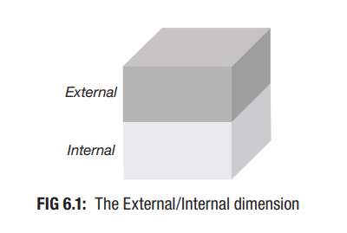
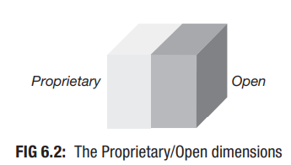
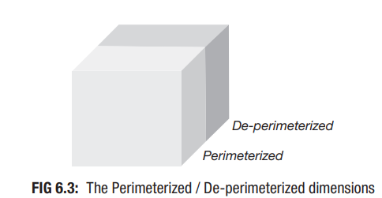
Dimensions of Cloud Cube Model
Data Boundary: Internal (I) vs. External (E) data boundaries.
Ownership: Proprietary (P) vs. Open (O) ownership models.
Security Boundary: Perimeterized (Per) vs. De-perimeterized (D-p) security approaches.
Sourcing: Insourced vs. Outsourced sourcing models.
Configurations: 16 possible configurations based on different dimension combinations.

Slide 77
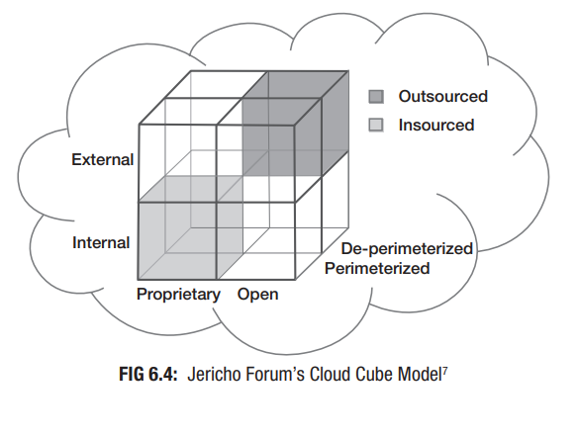
Visual Representation of Cloud Cube Model
Cube Visualization: Graphical representation of the Cloud Cube Model with axes for each dimension.
Configurations: Illustration of 16 unique configurations and their security characteristics.
Application: Examples of configurations to demonstrate how the model can be used to assess and enhance cloud security strategies.

Slide 78
Examining Cloud Security vs. Traditional Computing
Shared Responsibility Model:
Cloud security is a collaborative effort involving both cloud service providers and consumers.
Providers ensure the security of the cloud infrastructure, while consumers are responsible for securing their own data and applications within the cloud.
Roles and Responsibilities:
Service Providers: Handle physical security, network security, and virtualization.
Consumers: Manage data security, application security, and identity management.
Cloud Security Reference Model:
Provides a framework for evaluating and enhancing cloud security.
Helps in defining responsibilities and security measures for different layers and service models.
Shift in Security Responsibilities:
IaaS (Infrastructure as a Service): Consumers manage most security aspects, including OS and applications.
PaaS (Platform as a Service): Providers handle the platform security; consumers manage applications.
SaaS (Software as a Service): Providers manage most security aspects; consumers focus on application usage and data security.

Slide 79
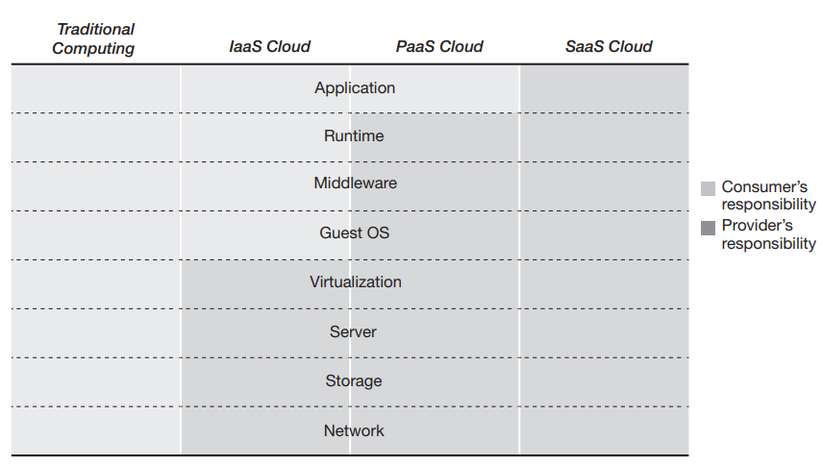
Examining Cloud Security vs. Traditional Computing

Slide 80
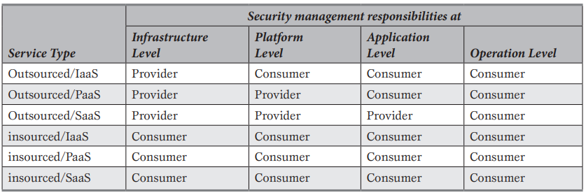
Examining Cloud Security vs. Traditional Computing

Slide 81
Security Management Responsibilities
IaaS (Infrastructure as a Service):
Provider: Manages the physical infrastructure (servers, storage, network).
Consumer: Responsible for managing the operating system, applications, and data.
PaaS (Platform as a Service):
Provider: Manages infrastructure and platform services (runtime environments, middleware).
Consumer: Manages applications and data security.
SaaS (Software as a Service):
Provider: Handles the entire stack, including infrastructure, platform, and applications.
Consumer: Focuses on managing user data and access.
Traditional Computing:
Consumers: Handle all aspects of security from physical hardware to application-level security.
In-house Management: Requires comprehensive security measures across all layers, including hardware, network, and software.

Slide 82
Cloud Security Advantages
Provider Expertise: Reputable cloud providers offer robust security measures.
01
Focused Responsibility: Consumers manage less security compared to traditional setups.
02
Potential for Enhanced Security: Properly selected cloud models can provide stronger security than traditional environments.
03
Insourced Cloud Models: Similar to traditional in-house computing, offering full control over security.
04

Slide 83
Security Management in Cloud Environments
Outsourced/IaaS: Provider handles infrastructure; consumer manages platform, application, and operations.
Outsourced/PaaS: Provider handles infrastructure and platform; consumer manages application and operations.
Outsourced/SaaS: Provider manages everything except application-level security.
Insourced Models: Consumers handle all security responsibilities across all levels.

Slide 84
Traditional vs. Cloud Computing Security
Outsourcing Comparison:
Both traditional and cloud computing involve outsourcing, with associated security risks.
In traditional computing, enterprises often outsourced IT services to third parties.
Public Cloud Concerns:
Public clouds raise concerns due to limited consumer control over security.
Consumers may worry about the security of data and applications managed by third-party providers.
Third-Party Management:
Security risks are inherent in both cloud and traditional outsourcing scenarios.
Trust in third-party vendors is crucial for managing these risks effectively.
Provider Reputation:
Major cloud providers with strong reputations (e.g., Google, Amazon, Microsoft) offer robust security measures.
Adoption of services from reputable providers can mitigate security concerns and offer better protection.

Slide 85
Security Policies in Cloud Computing
Management Policy:
High-level policy set by senior management.
Includes guidelines on backup frequency, cloud deployment choices, and sourcing decisions.
Regulatory Policy:
Industry or government-imposed policies for compliance.
Ensures adherence to legal, regulatory, and industry-specific requirements.
Advisory Policy:
Recommended practices for enhancing security.
May include suggestions for periodic security audits and other preventive measures.
Informative Policy:
Aims to raise awareness about security issues.
Targets both internal and external stakeholders, providing information on specific security scenarios.

Slide 86
Trusted Cloud Computing
Trusted Computing:
Technologies and policies designed to create secure and reliable computing systems.
Trust in cloud computing is essential for widespread adoption.
Trust Challenges:
Consumer scepticism regarding cloud security.
Efforts by providers to address concerns about insider and outsider threats.
Certification Programs:
Certifications like CSA STAR provide assurance of security and compliance.
Act as quality stamps for cloud services, boosting consumer confidence.
Provider Transparency:
Major providers (e.g., Google, Amazon, Microsoft) work to increase transparency regarding their security practices.
Ongoing efforts to build and maintain trust with consumers.

Slide 87
How to Make a Cloud Service Trusted
Provider Responsibilities: Strengthening security measures and transparency.
Consumer Queries: Encouraging consumers to inquire about security measures.
Security Certification: Obtaining certifications from recognized organizations (e.g., CSA STAR).
Reputation Building: Trust is developed over time with consistent security and transparency.

Slide 88
CHAPTER 3 Microsoft Azure Cloud Compute Services
|LEARNING MICROSOFT AZURE

Slide 89
Introduction to Azure Compute Services
Overview of Microsoft Azure: A leading cloud provider offering a wide array of cloud services for businesses.
Azure Compute Services: Empower organizations to run workloads in the cloud with scalable and flexible compute resources.
Key Use Cases:
Application migration from on-premises to cloud
Containerization to run apps in isolated environments
Modernization of legacy systems using cloud-native services

Slide 90
What is Azure Compute?
On-demand Computing Resources:
Virtual Disks: High-capacity storage that can be attached to VMs.
Memory and Processors: Scalable resources to handle varying workloads.
Networking: Private and public networking solutions to connect resources securely.
Flexible Pricing Models:
Pay-as-you-go: Pay only for the resources you use.
Reserved Instances: Lock in lower prices for longer commitments.
Rapid Deployment: Cloud computing services can be provisioned in minutes, reducing infrastructure setup time.

Slide 91
Key Azure Compute Services
Azure Virtual Machines (VMs): Traditional IaaS model offering full control over OS and infrastructure.
Azure VM Scale Sets: Autoscaling feature that enables the creation of thousands of identical VMs to meet demand.
Azure App Services: PaaS offering for building and hosting web apps, APIs, and mobile backends without managing infrastructure.
Azure Container Apps: Lightweight, cloud-native applications that run in containers, making them portable and scalable.
Azure Functions: Serverless compute for event-driven workloads, automatically scaling based on demand.
Azure Kubernetes Service (AKS): Managed container orchestration for running Kubernetes clusters in the cloud.

Slide 92
Azure Compute Benefits
Fully Managed Systems: Reduce operational overhead with Microsoft managing infrastructure.
Better Security: Built-in security controls, compliance certifications, and access management.
Innovation & Rapid Development: Scale up or down quickly, enabling teams to innovate without waiting for hardware procurement.
Cost Savings: Avoid upfront capital expenses for physical infrastructure and pay only for what you use.
Hybrid and On-Premises Support: Connect existing on-premises resources to Azure for hybrid cloud solutions.

Slide 93
Azure Virtual Machines
Full Infrastructure Control: Ideal for organizations that want complete control over their infrastructure, including OS management.
OS Support:
Windows: Full range of Windows Server versions.
Linux: Popular distributions like Ubuntu, CentOS, and RedHat.
Use Cases:
Lift-and-Shift Migration: Easily migrate on-premises applications to the cloud.
DevOps Integration: VMs can be used as DevOps agents in CI/CD pipelines.
Testing Environments: Create isolated VMs for development and testing purposes.

Slide 94
Azure VM Scale Sets
Autoscaling & Load-Balancing: Automatically increase or decrease the number of VMs based on demand.
Quick Provisioning: Deploy thousands of VMs in minutes, ideal for handling burst workloads.
No Pre-Provisioning Required: VMs are dynamically created and deallocated as needed, reducing costs.
Big Data & Containerized Workloads: Scale sets are ideal for handling large datasets and running container-based applications.
Use Cases:
CI/CD Pipelines: Scale sets can be used as agents for build and release pipelines in Azure DevOps.
High-Demand Workloads: Deploy scalable instances for handling heavy traffic and computational needs.

Slide 95
Scaling in Azure VMSS
Horizontal Scaling:
Add or remove VMs from a scale set to handle varying loads.
Ideal for applications where adding more instances increases performance (e.g., web apps, services).
Vertical Scaling:
Add more CPU, memory, or storage to existing VMs to handle increased load.
Suitable for scenarios where individual VM performance needs to be enhanced.
Manual & Autoscaling:
Azure VMSS supports both manual and automatic scaling, giving flexibility for both planned and unplanned workload spikes.

Slide 96
Cloud Migration & Lift-and-Shift
Lift-and-Shift:
Minimal Code Refactoring: Move existing applications to Azure with minimal changes.
Faster Migration: Transition applications to the cloud quickly without redesigning them.
Cost Efficiency: Reduces costs associated with maintaining physical infrastructure.
Hybrid Deployment: Combine on-premises and cloud resources for better scalability and redundancy.

Slide 97
Important Considerations for Azure VMs
Networking:
Use Azure VNets to ensure secure connections between VMs and other cloud resources.
VNets enable private, secure communication between Azure resources.
VM Sizing:
Select appropriate VM sizes based on your workload (compute, memory, storage needs).
Storage:
VMs use virtual hard disks (VHDs), including OS disks and temporary storage.
Select the correct disk performance (Standard, Premium) based on your requirements.
Operating System:
Choose between various Windows or Linux images available in Azure.
The cost of VMs includes the OS license, which affects the pricing model.

Slide 98
Azure Hybrid Benefit & Spot VMs
Azure Hybrid Benefit:
Allows organizations to use their on-premises Windows Server and SQL Server licenses on Azure VMs, reducing costs.
Useful for companies with existing Software Assurance licenses.
Savings Calculator: Estimate the cost savings of using Azure Hybrid Benefit for workloads.
Azure Spot VMs:
Take advantage of unused Azure capacity at a lower cost.
Spot VMs can be deallocated when Azure needs capacity for other workloads, making them ideal for fault-tolerant applications like batch jobs.

Slide 99
Azure App Service: A Platform as a Service (PaaS)
Azure App Service is a fully managed PaaS offering that enables developers to build, deploy, and scale web apps, mobile backends, and APIs in an enterprise-grade environment.
Provides built-in infrastructure management (including security patching and load balancing).
No need to manage physical servers, virtual machines, or networks.
Use Cases: Enterprise applications, mobile backends, microservices, RESTful APIs, and more.

Slide 100
Benefits of Azure App Service Over Traditional Hosting
Rapid Deployment: Supports continuous deployment with GitHub, Azure DevOps, and Bitbucket.
Cost-Effective: Pay-as-you-go pricing models to optimize costs.
Seamless Scaling: Automatically scale up or down based on demand.
Managed Infrastructure: Eliminates the need for managing physical infrastructure, reducing overhead.

Slide 101
Key Features of Azure App Service
Language and Framework Support: Supports .NET, Java, Node.js, PHP, Python, Ruby, and Docker.
Environment Flexibility: Easily deploy applications in containers using Docker or integrate with Azure Kubernetes Service (AKS).
Auto-Patching and Load Balancing: Automatic OS and framework patching to secure apps and prevent downtime.
Global Deployment: Easily deploy your app globally for better availability using Azure’s global data centers.
Integrated Monitoring: Use Azure Monitor and Application Insights for diagnostics and performance tracking.

Slide 102
Continuous Integration & Deployment with Azure App Service
CI/CD Integration: Integrate with popular CI/CD tools like GitHub, Bitbucket, Azure DevOps, and Jenkins for automated build and deployment pipelines.
Container Support: Deploy Docker containers directly to Azure App Service or use Docker Compose for multi-container apps.
Zero Downtime Deployment: Use deployment slots to create staging environments and swap without downtime.
Git-based Deployment: Directly push code to Azure App Service via Git to deploy and manage updates.

Slide 103
Scaling and Load Balancing
Automatic Scaling: Scale applications based on predefined rules, traffic loads, or resource consumption (CPU/memory usage).
Horizontal Scaling: Scale out to multiple instances to distribute traffic.
Vertical Scaling: Scale up by increasing the size of the VMs supporting your app (use larger VMs for intensive workloads).
Global Load Balancing: Built-in load balancing across multiple regions for high availability.
Scaling Plans: Available across different pricing tiers, from basic to premium.

Slide 104
High Availability and Disaster Recovery
Uptime SLA: Azure guarantees a 99.95% uptime SLA for App Service.
Geo-Redundancy: Deploy applications across multiple regions for geo-redundancy and failover.
Backup and Restore: Schedule regular backups of your application data and restore from any point.
Disaster Recovery: Use disaster recovery plans for critical applications with hot, cold, or warm failover strategies.

Slide 105
Security and Compliance
Built-in Security Features:
SSL certificates: Free and managed SSL for your custom domains.
DDoS Protection: Azure’s infrastructure provides automatic protection against Distributed Denial of Service (DDoS) attacks.
IP Address Restrictions: Configure IP restrictions to allow or block traffic.
Identity and Access Control:
Integration with Microsoft Entra ID for secure authentication (OAuth, SAML, OpenID Connect).
Managed identities: Use built-in managed service identities to access Azure resources securely.
Compliance Certifications:
Meets multiple global compliance standards, including HIPAA, GDPR, ISO, and SOC.

Slide 106
Networking Features
Hybrid Connections: Securely connect your Azure apps to on-premise resources, databases, or VMs without complex VPN configurations.
Virtual Network (VNet) Integration: Integrate your app with an Azure VNet for secure private network access.
Private Endpoints: Secure access to your app service with private endpoints, keeping traffic within the Azure network.

Slide 107
Azure Web App for Containers
Custom Docker Images: Deploy custom Docker images to run your app within isolated containers.
Multi-Container Support: Use Docker Compose to run multi-container applications seamlessly.
Integration with Azure Kubernetes Service (AKS): Easily transition containerized apps to a Kubernetes cluster for large-scale deployment.

Slide 108
Azure Static Web Apps
Single-Page Applications (SPAs): Supports frameworks like Angular, React, Vue.js, and Blazor.
Built-in CI/CD: Automatically build and deploy from GitHub or Azure DevOps repositories.
Global CDN: Serve your static web content via Azure’s Content Delivery Network (CDN) for fast, worldwide access.
Custom Domains and Free SSL: Easily add custom domains and get free SSL certificates for secure access.

Slide 109
Serverless Computing
Definition: Serverless computing allows developers to build and run applications without managing servers.
Key Concept: The cloud provider (Azure) handles server management, scaling, and infrastructure maintenance.
Developer Focus: Developers focus on writing code and developing applications, not on server maintenance.
Usage Example: Running code in response to events like HTTP requests, database changes, or file uploads.

Slide 110
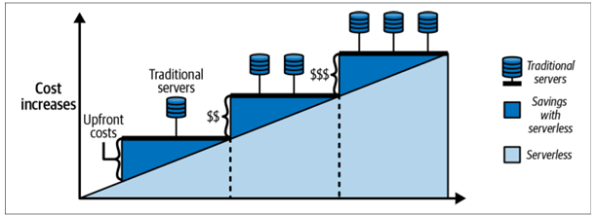
Why SERVERLESS?
Cost Efficiency: Pay only for actual usage; no costs for idle resources (consumption-based pricing).
Scalability: Automatically scales up or down based on demand.
Reduced Operational Overhead: No need to manage physical infrastructure or servers.
Focus on Code: Developers concentrate on coding rather than infrastructure management.

Slide 111
Azure Functions: The Core of Serverless Computing
Definition: Azure Functions is a serverless compute service that executes code in response to triggers.
Use Cases: Backend logic for APIs, integrations, event handling, data processing.
Event-Driven: Executes functions in response to events (HTTP requests, message queues, etc.).
Key Benefits:
Minimal code maintenance
Cost-effective (pay-as-you-go)
Flexibility in programming languages
Built-in autoscaling
Wide integration options with other Azure services

Slide 112
Components of Azure Functions
Triggers: Initiate function execution based on events (e.g., HTTP request, timer, queue message).
Example: HTTP Trigger, Timer Trigger, Blob Trigger.
Bindings: Connect input and output resources to the function.
Input Bindings: Receive data from a source (e.g., queue, blob storage).
Output Bindings: Send data to a destination (e.g., database, queue).
Direction Properties:
In: Data coming into the function.
Out: Data going out of the function.
InOut: Data both coming in and going out (for certain bindings).

Slide 113
Creating Azure Functions
Supported Languages: C#, Java, JavaScript, Python, TypeScript, PowerShell, etc.
Development Tools: Azure Portal, Visual Studio, Visual Studio Code.
Getting Started: Follow Microsoft’s guide for creating your first Azure Function.

Slide 114
Azure Durable Functions: Extending Serverless with Stateful Workflows
Definition: Extension of Azure Functions for creating stateful workflows and orchestration.
Purpose: Manage complex workflows with long-running operations and state management.
Benefits:
Automates business processes
Manages state and checkpoints
Reduces manual state management coding
Supports multiple languages (C#, JavaScript, Python, F#, PowerShell)

Slide 115
Features and Benefits of Azure Durable Functions
Stateful Workflows: Maintains state across function executions.
Complex Workflow Handling: Automate scenarios like approval workflows or waiting for external events.
Reduced Infrastructure Maintenance: Focus on developing logic instead of managing infrastructure.
Cost Efficiency: Pay only when function apps are running.
Integration Flexibility: Easily integrates with other Azure services and APIs.

Slide 116
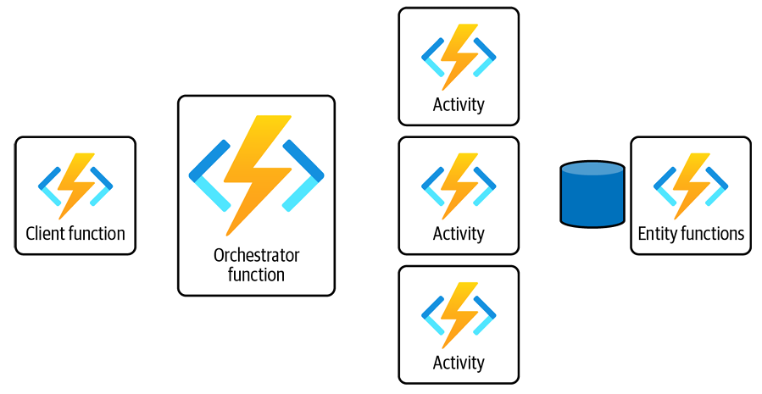
Components of Azure Durable Functions
Client Functions: Initiate the orchestration workflow. Example: HTTP-triggered client function.
Orchestrator Functions: Manage the execution and coordination of workflows. Example: Orchestrator function handling business logic.
Activity Functions: Perform individual tasks within workflows. Example: Functions performing data processing.
Entity Functions: Manage stateful entities within workflows. Example: Functions managing user states or session data.

Slide 117
Client Functions
Function: Start orchestration by triggering an orchestrator function.
Example: Triggered by HTTP, Blob storage, or Queue messages.
Example Code:
[FunctionName("BlobTriggerStart")]
public static async Task BlobTriggerClientFunction(
[BlobTrigger("photoscontainer/{name}", Connection ="StorageConnectionString")]
CloudBlockBlob myBlob, string name,
ILogger log, [DurableClient] IDurableOrchestrationClient starter)
{
// Function logic
}

Slide 118
Orchestrator Functions
Role: Defines the sequence of tasks and workflow.
Characteristics: Must be deterministic.
Tasks: Can include activity functions, sub-orchestrations, and external events.
Example Code:
[FunctionName("StorageOrchestrator")]
public static async Task<string> RunOrchestrator(
[OrchestrationTrigger] IDurableOrchestrationContext context, ILogger log)
{
// Function logic
}

Slide 119
Activity Functions
Role: Execute individual tasks within a workflow.
Characteristics: Short-lived and specific to a task.
Usage: Can run in parallel or sequentially.
Example Code:
[FunctionName("SendMessageToServiceBusQueue")]
public static async Task<string> SendMessageToAzureServiceBusQueueAsync(
[ActivityTrigger] CloudBlobItem uploadedBlob, ILogger log, ExecutionContext executionContext)
{
// Function logic
}

Slide 120
Entity Functions
Role: Manages stateful entities with persistence.
Characteristics: Encapsulates state and behavior in a class.
Usage: Handles entities like users, orders, or inventory.
Key Features:
Optimistic Concurrency Control: Ensures consistency across concurrent operations.
Durable State Management: Maintains and updates entity state reliably.

Slide 121
Developing Durable Functions
Define Client Functions: Trigger orchestration with a specific binding.
Implement Orchestrator Functions: Design workflows and handle business logic.
Create Activity Functions: Break down tasks and manage execution.
Manage Entity Functions: Handle stateful entities and ensure consistency.
Resources:
Microsoft Documentation on Azure Durable Functions
GitHub: Durable Task Framework

Slide 122
Common Patterns and Use Cases
Function Chaining: Sequence tasks in a specific order.
Fan-out/Fan-in: Execute tasks in parallel and aggregate results.
Human Interaction: Wait for external events like user input or approval.
Stateful Entities: Manage distributed stateful objects.
Examples:
Order Processing: Handle inventory checks, notifications, and shipments.
Approval Workflows: Automate processes requiring human intervention.

Slide 123
Uses and Benefits of Entity Functions
Scalability
Handles many concurrent requests
Scales dynamically to meet demand
Reliability
Durable state storage
Highly available and fault-tolerant
Consistency
Optimistic concurrency control
Ensures correct order of updates
Encapsulation
Encapsulates logic and state in a single class
Easier to maintain and evolve
Reusability
Can be used across multiple workflows
Reuse stateful entities in different parts of an application

Slide 124
Durable Function Types
Stateful: Orchestrator and Entity Functions
Stateless: Client and Activity Functions

Slide 125
Application Patterns: Function Chaining
Sequential execution of functions
Each function’s output is the next function’s input
[FunctionName("FunctionChainingExample")]
public static async Task<object> Run([OrchestrationTrigger] IDurableOrchestrationContext context)
{
var res1 = await context.CallActivityAsync<object>("myfunc1", null);
var res2 = await context.CallActivityAsync<object>("myfunc2", res1);
var finalresult = await context.CallActivityAsync<object>("myfunc3", res2);
return await context.CallActivityAsync<object>("myfunc4", finalresult);
}

Slide 126
Application Patterns: Fan-out/Fan-in
Executes multiple functions in parallel
Aggregates results
[FunctionName("FanOutFanInExample")]
public static async Task Run([OrchestrationTrigger] IDurableOrchestrationContext context)
{
var parallelTasks = new List<Task<int>>();
object[] workBatch = await context.CallActivityAsync<object[]>("F1", null);
for (int i = 0; i < workBatch.Length; i++)
{
Task<int> task = context.CallActivityAsync<int>("F2", workBatch[i]);
parallelTasks.Add(task);
}
await Task.WhenAll(parallelTasks);
int sum = parallelTasks.Sum(t => t.Result);
await context.CallActivityAsync("F3", sum);
}

Slide 127
Application Patterns: Async HTTP APIs
Handle long-running operations via HTTP
Redirect client to a status endpoint
[FunctionName("CheckWebsiteContentFunction")]
public static async Task CheckWebsite([OrchestrationTrigger] IDurableOrchestrationContext context, ILogger log)
{
Uri jonahsWebsite = new Uri("https://jonahandersson.tech");
DurableHttpResponse httpResponse = await context.CallHttpAsync(HttpMethod.Get, jonahsWebsite);
log.LogInformation($"Response Code: {httpResponse.StatusCode}");
log.LogInformation($"Content: {httpResponse.Content}");
}

Slide 128
Application Patterns: Monitor Pattern
Regular polling to check for conditions or job status
[FunctionName("MonitorCleanUpJobStatus")]
public static async Task Run([OrchestrationTrigger] IDurableOrchestrationContext context)
{
int cleanUpJobId = context.GetInput<int>();
int jobPollingInterval = GetPollingInterval();
DateTime expirationTime = GetExpiryTime();
string emailAddress = GetEmailAddress();
while (context.CurrentUtcDateTime < expirationTime)
{
var status = await context.CallActivityAsync<string>("GetJobCleanUp", cleanUpJobId);
if (status == "Completed")
{
await context.CallActivityAsync("SendMonitoringAlert", emailAddress);
break;
}
var nextMonitorCheck = context.CurrentUtcDateTime.AddSeconds(jobPollingInterval);
await context.CreateTimer(nextMonitorCheck, CancellationToken.None);
}
}

Slide 129
Application Patterns: Human Interaction
Handle processes requiring human input or approval
[FunctionName("ApprovalFromManagerWorkflow")]
public static async Task Run([OrchestrationTrigger] IDurableOrchestrationContext context)
{
await context.CallActivityAsync("RequestApprovalFromManager", null);
using (var timeout = new CancellationTokenSource())
{
DateTime dueTime = context.CurrentUtcDateTime.AddHours(72);
Task durableTimeout = context.CreateTimer(dueTime, timeout.Token);
Task<bool> humanInteractionEvent = context.WaitForExternalEvent<bool>("ManagerApprovalEvent");
if (humanInteractionEvent == await Task.WhenAny(humanInteractionEvent, durableTimeout))
{
timeout.Cancel();
await context.CallActivityAsync("ProcessRequest", humanInteractionEvent.Result);
}
else
{
await context.CallActivityAsync("EscalateToAnotherPerson", null);
}
}
}

Slide 130
Best Practices for Using Azure Functions and Durable Functions
Scalability: Design functions to handle varying loads and leverage autoscaling features.
Error Handling: Implement robust error handling and retry policies.
Monitoring and Logging: Use Azure Monitor and Application Insights for monitoring and debugging.
Security: Secure your functions with appropriate authentication and authorization.

Slide 131
Introduction to Container Services in Azure
Overview:
Modernizing applications with containers
Benefits of using containers in Azure
Advantages:
Cost Savings: Lift-and-shift applications to the cloud without major changes
Development and CI/CD: Simplify development and continuous integration/continuous deployment
Integration: Seamless integration with Microsoft Entra ID for user access management and security

Slide 132
Azure Container Instances (ACI)
What is ACI?
Service for running containers in Azure without managing VMs
Ideal for quick deployment and isolation of applications
Key Features:
Dynamic Scaling: Scale containers up or down based on demand
Task Automation: Run and manage containerized tasks efficiently
Isolation: Containers run independently on shared or dedicated resources

Slide 133
Azure Kubernetes Service (AKS)
What is AKS?
Managed Kubernetes service for orchestrating containerized applications
Key Features:
Container Orchestration: Automated deployment, scaling, and management of containerized apps
Hybrid Deployment: Support for on-premises, cloud, and hybrid infrastructures
Security: Network security, role-based access control, and container isolation
CI/CD Integration: Works with Azure DevOps, GitHub, Jenkins, etc.
Monitoring & Auto-Scaling: Automated upgrades, self-healing, node auto-repair

Slide 134
Azure Container Registry (ACR)
What is ACR?
Managed service for storing and managing container images
Key Features:
RBAC (Role-Based Access Control): Control access to container images
Geo-Replication: Replicate container images across multiple Azure regions
Image Scanning: Scan for vulnerabilities and security issues
Deployment Best Practices:
Regional Deployment: Deploy ACR in the same region as your containers to reduce latency
Geo-Replication: Enable for improved availability and resiliency

Slide 135
Azure Container Apps (ACA)
Overview:
Serverless container service for building and deploying applications and microservices
Key Features:
Serverless Model: No need to manage underlying infrastructure
Built-In Authentication: Support for multiple identity providers (Microsoft Identity Platform, Google, Twitter, etc.)
Lifecycle Phases: Deployment, Update, Deactivation, Shutdown
Uses and Benefits:
Microservices: Develop and manage microservices applications
API Endpoints: Autoscale based on HTTP traffic
Background Processing: Run stateful and long-running jobs
Event-Driven Processing: Manage and autoscale event-driven tasks

Slide 136
Azure Quantum
What is Quantum Computing?
Utilizes quantum mechanics to solve complex problems faster than on classical computers
Applications:
Cryptography: Enhance security protocols
Mechanical Systems Simulation: Model complex systems
Machine Learning: Improve learning algorithms
Optimization Problems: Solve complex optimization tasks

Slide 137
Azure Quantum Platform
Overview:
Cloud service offering quantum solutions and technologies
Prepares for future quantum advancements
Key Components:
Azure Quantum Development Kit (Azure QDK): Develop with Q#, run on quantum hardware or optimization solvers
Q# Programming Language: Focused on quantum algorithm development
Learning Resources:
Microsoft Learning Path: Quantum Computing Foundations
Q# Community: Code examples, documentation, and community support

